Slide 1
Serverless Computing: One Step Forward, Two Steps Back
Joe Hellerstein, Jose Faleiro, Joey Gonzalez, Johann Schleier-Smith, Vikram Sreekanti, Alexey Tumanov, Chenggang Wu

Slide 2
Outline
1
Promise, Potential, Scope
2
What Works, What’s Broke
3
Objections from the Wild
4
Moving Forward on Cloud Programming

Slide 3
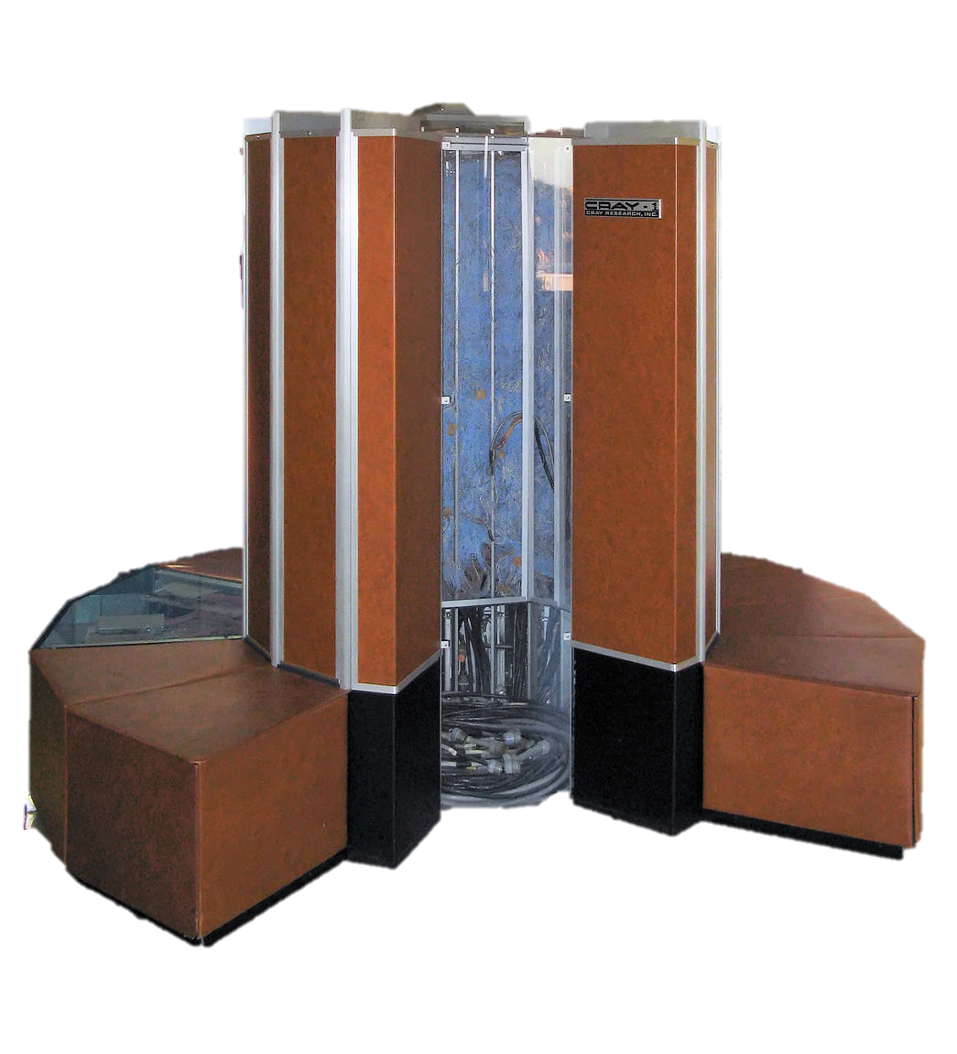
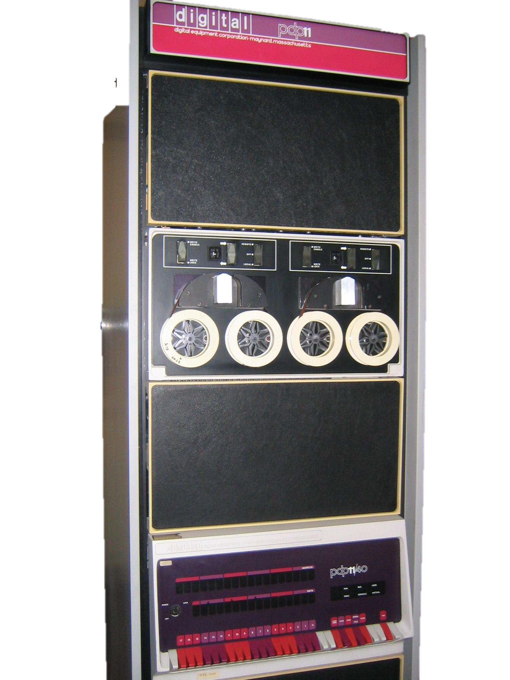
Sea Changes in Computing
Smart Phones
Personal Computers
Supercomputers
Minicomputers
iPhone, 2007
Macintosh, 1984
Cray-1, 1976
PDP-11, 1970
Notes:
PDP-11 photo By Stefan_Kögl - Own work, CC BY-SA 3.0, https://commons.wikimedia.org/w/index.php?curid=466937
Mac photo from https://bytemyvdu.wordpress.com/category/plus/
Cray-1 photo By Clemens PFEIFFER - Own work, CC BY 2.5, https://commons.wikimedia.org/w/index.php?curid=1441453
iPhone photo from https://www.imore.com/iphone-2g

Slide 4
New Platform + New Language = Innovation
Smart Phones
Personal Computers
Supercomputers
Minicomputers
iPhone, 2007
Macintosh, 1984
Cray-1, 1976
PDP-11, 1970
Notes:
PDP-11 photo By Stefan_Kögl - Own work, CC BY-SA 3.0, https://commons.wikimedia.org/w/index.php?curid=466937
Mac photo from https://bytemyvdu.wordpress.com/category/plus/
Cray-1 photo By Clemens PFEIFFER - Own work, CC BY 2.5, https://commons.wikimedia.org/w/index.php?curid=1441453
iPhone photo from https://www.imore.com/iphone-2g

Slide 5
Suppose I offered you a computer that was actually…
Notes:
1-8 DCs per region
50K-80K servers per DCh
https://www.forbes.com/sites/johnsonpierr/2017/06/15/with-the-public-clouds-of-amazon-microsoft-and-google-big-data-is-the-proverbial-big-deal/#22c077952ac3
2018: 50 AZs

Slide 6
I’m Not Joking
Some SWAGs at numbers
AWS: ~10 million servers
60 Availability Zones¹
1-8 Datacenters per AZ²
50K-80K servers per DC²
½ of all storage bytes shipped are now to Hyperscalars³
¹https://aws.amazon.com/about-aws/global-infrastructure/
²https://www.forbes.com/sites/johnsonpierr/2017/06/15/with-the-public-clouds-of-amazon-microsoft-and-google-big-data-is-the-proverbial-big-deal/
³http://chansblog.com/impact-from-public-cloud-on-the-storage-industry-an-insight-from-snia-at-sfd12/

Slide 7
This is Happening
https://edu.google.com/latest-news/stories/mit-gpc

Slide 8
The Big Query
How will folks program the cloud?
In a way that fosters unexpected innovation
Distributed programming is hard!
Parallelism, consistency, partial failure, …
Prevailing answers
Batch: SQL or MapReduce
Otherwise: Java?
Surely there’s something more!

Slide 9
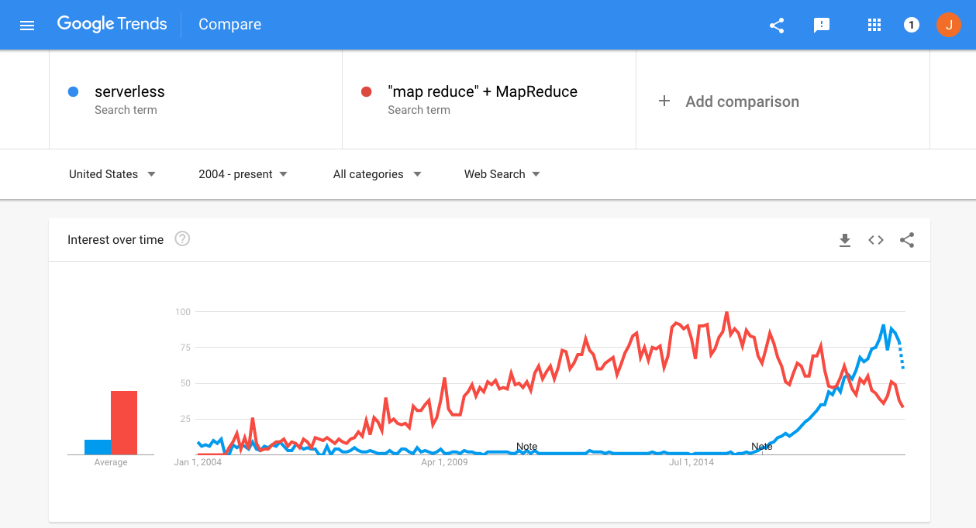
Serverless Computing: The New Hotness

Slide 10
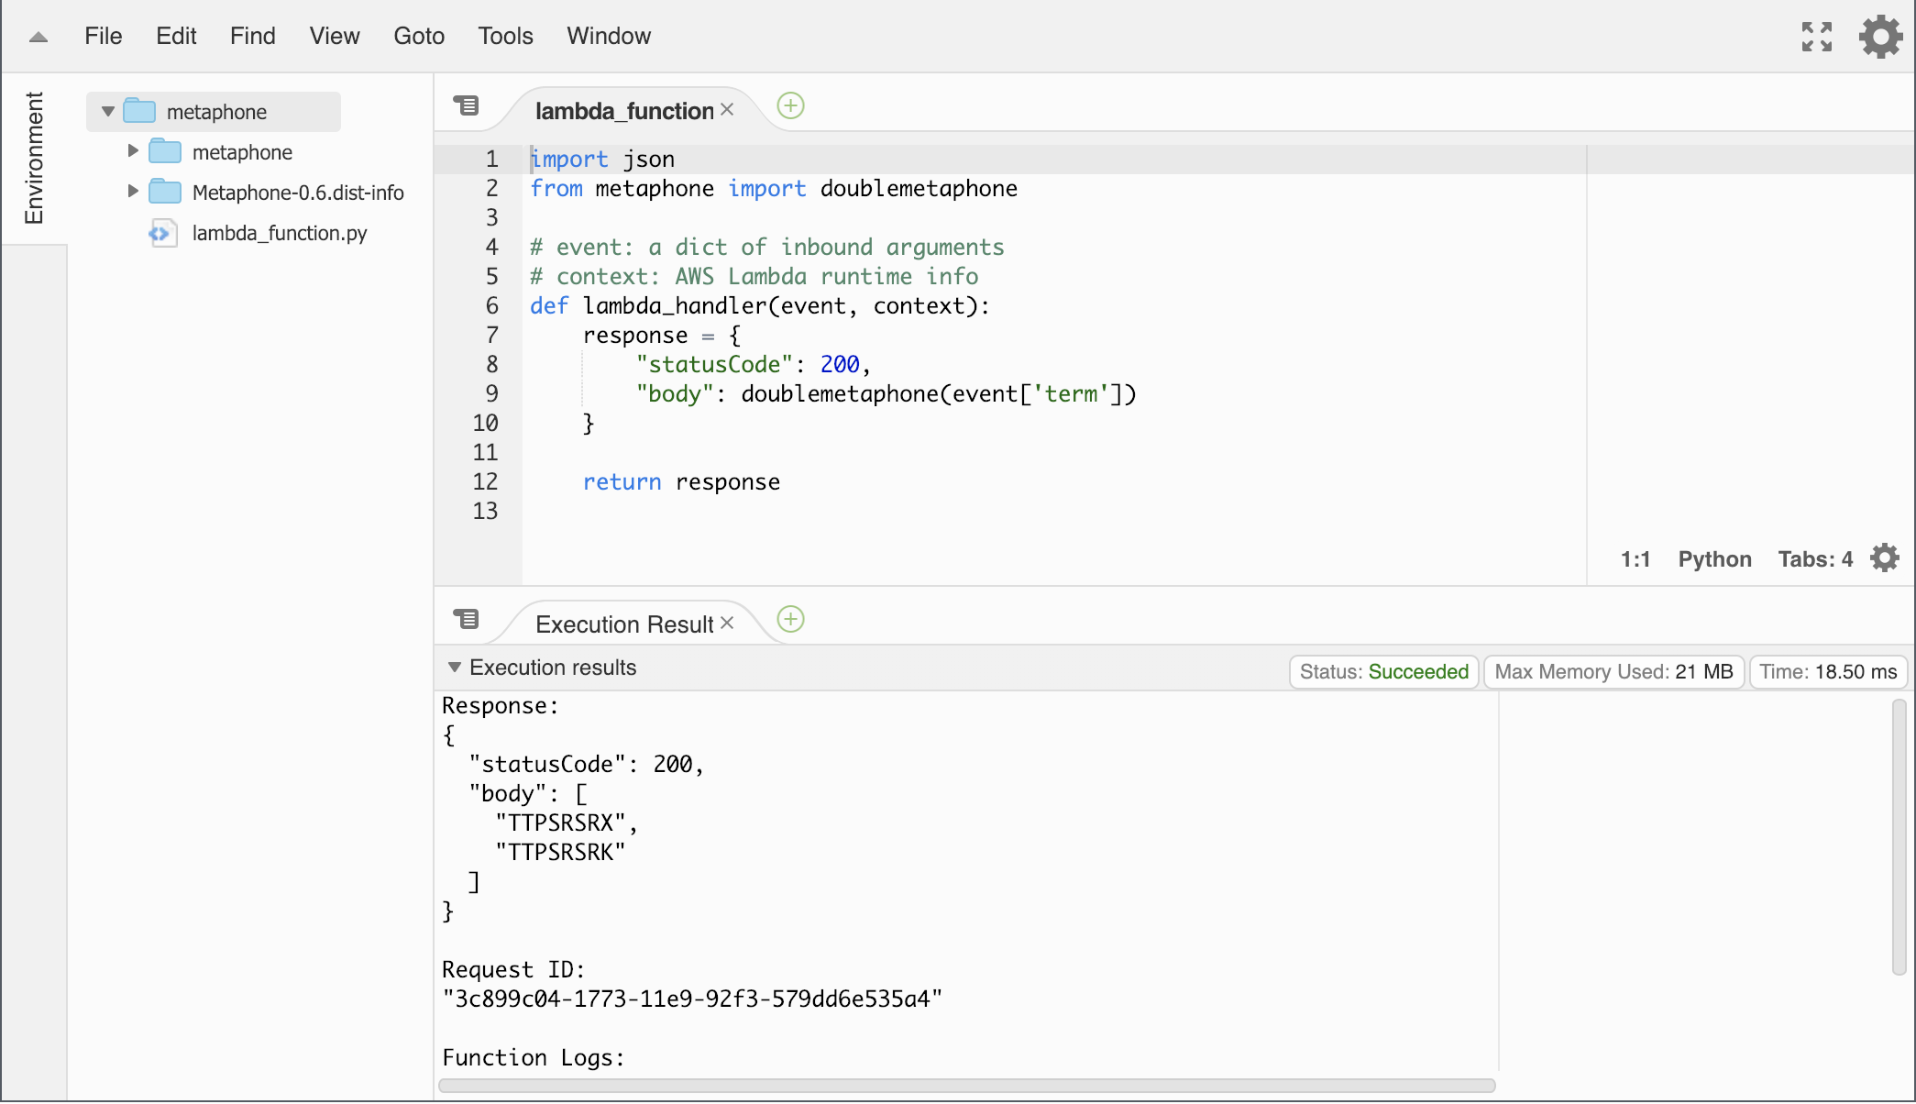
What is Serverless Computing?
Vague marketing buzzphrase
Many people define it many ways.
Let’s go with what’s being sold: Functions-as-a-Service (FaaS)
We studied AWS Lambda carefully
Most of this applies across vendors
A snapshot in time! (~10/2018)

Slide 11
A Pure Functional Lambda

Slide 12
FaaS Also Comes with a “Standard Library”
The autoscaling services offered by the vendor
E.g. Queuing (AWS SQS, SNS) for function input/output, Storage (AWS S3, DynamoDB)
E.g. DSL-based compute libraries (Google Cloud Dataflow, Azure Stream Analytics)
Serverless = FaaS + Autoscaling Services
Much like C isn’t very interesting without stdlib
In reality not a “standard” library
Proprietary APIs, differing services for each vendor (based on what is autoscaling)

Slide 13
Outline
1
Promise, Potential, Scope
2
What Works, What’s Broke
3
Objections from the Wild
4
Moving Forward on Cloud Programming

Slide 14
3 Promises of the Cloud
Autoscaling
Scalable Data Processing
Distributed Computing

Slide 15
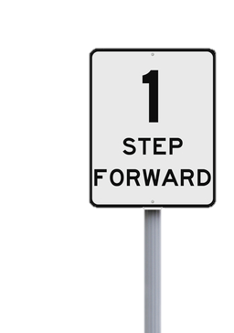
3 Promises of the Cloud
❌
Scalable Data Processing
Distributed Computing
❌
1
STEP FORWARD
2
STEPS BACK
✅
Autoscaling

Slide 16
Earlier I Said…
1
STEP FORWARD
“Distributed programming is hard”
In general!
Not everything is hard!

Slide 17
Scenario 1: Embarrassingly Parallel Code
Lots of modern examples
Image/Video processing, one at a time
Simple featurization of objects in ML pipelines
Etc.
PyWren, ExCamera, …
An Autoscaling Version of…
“Map”, SQL UDFs, Web CGI, …
f()
f()
f()

Slide 18
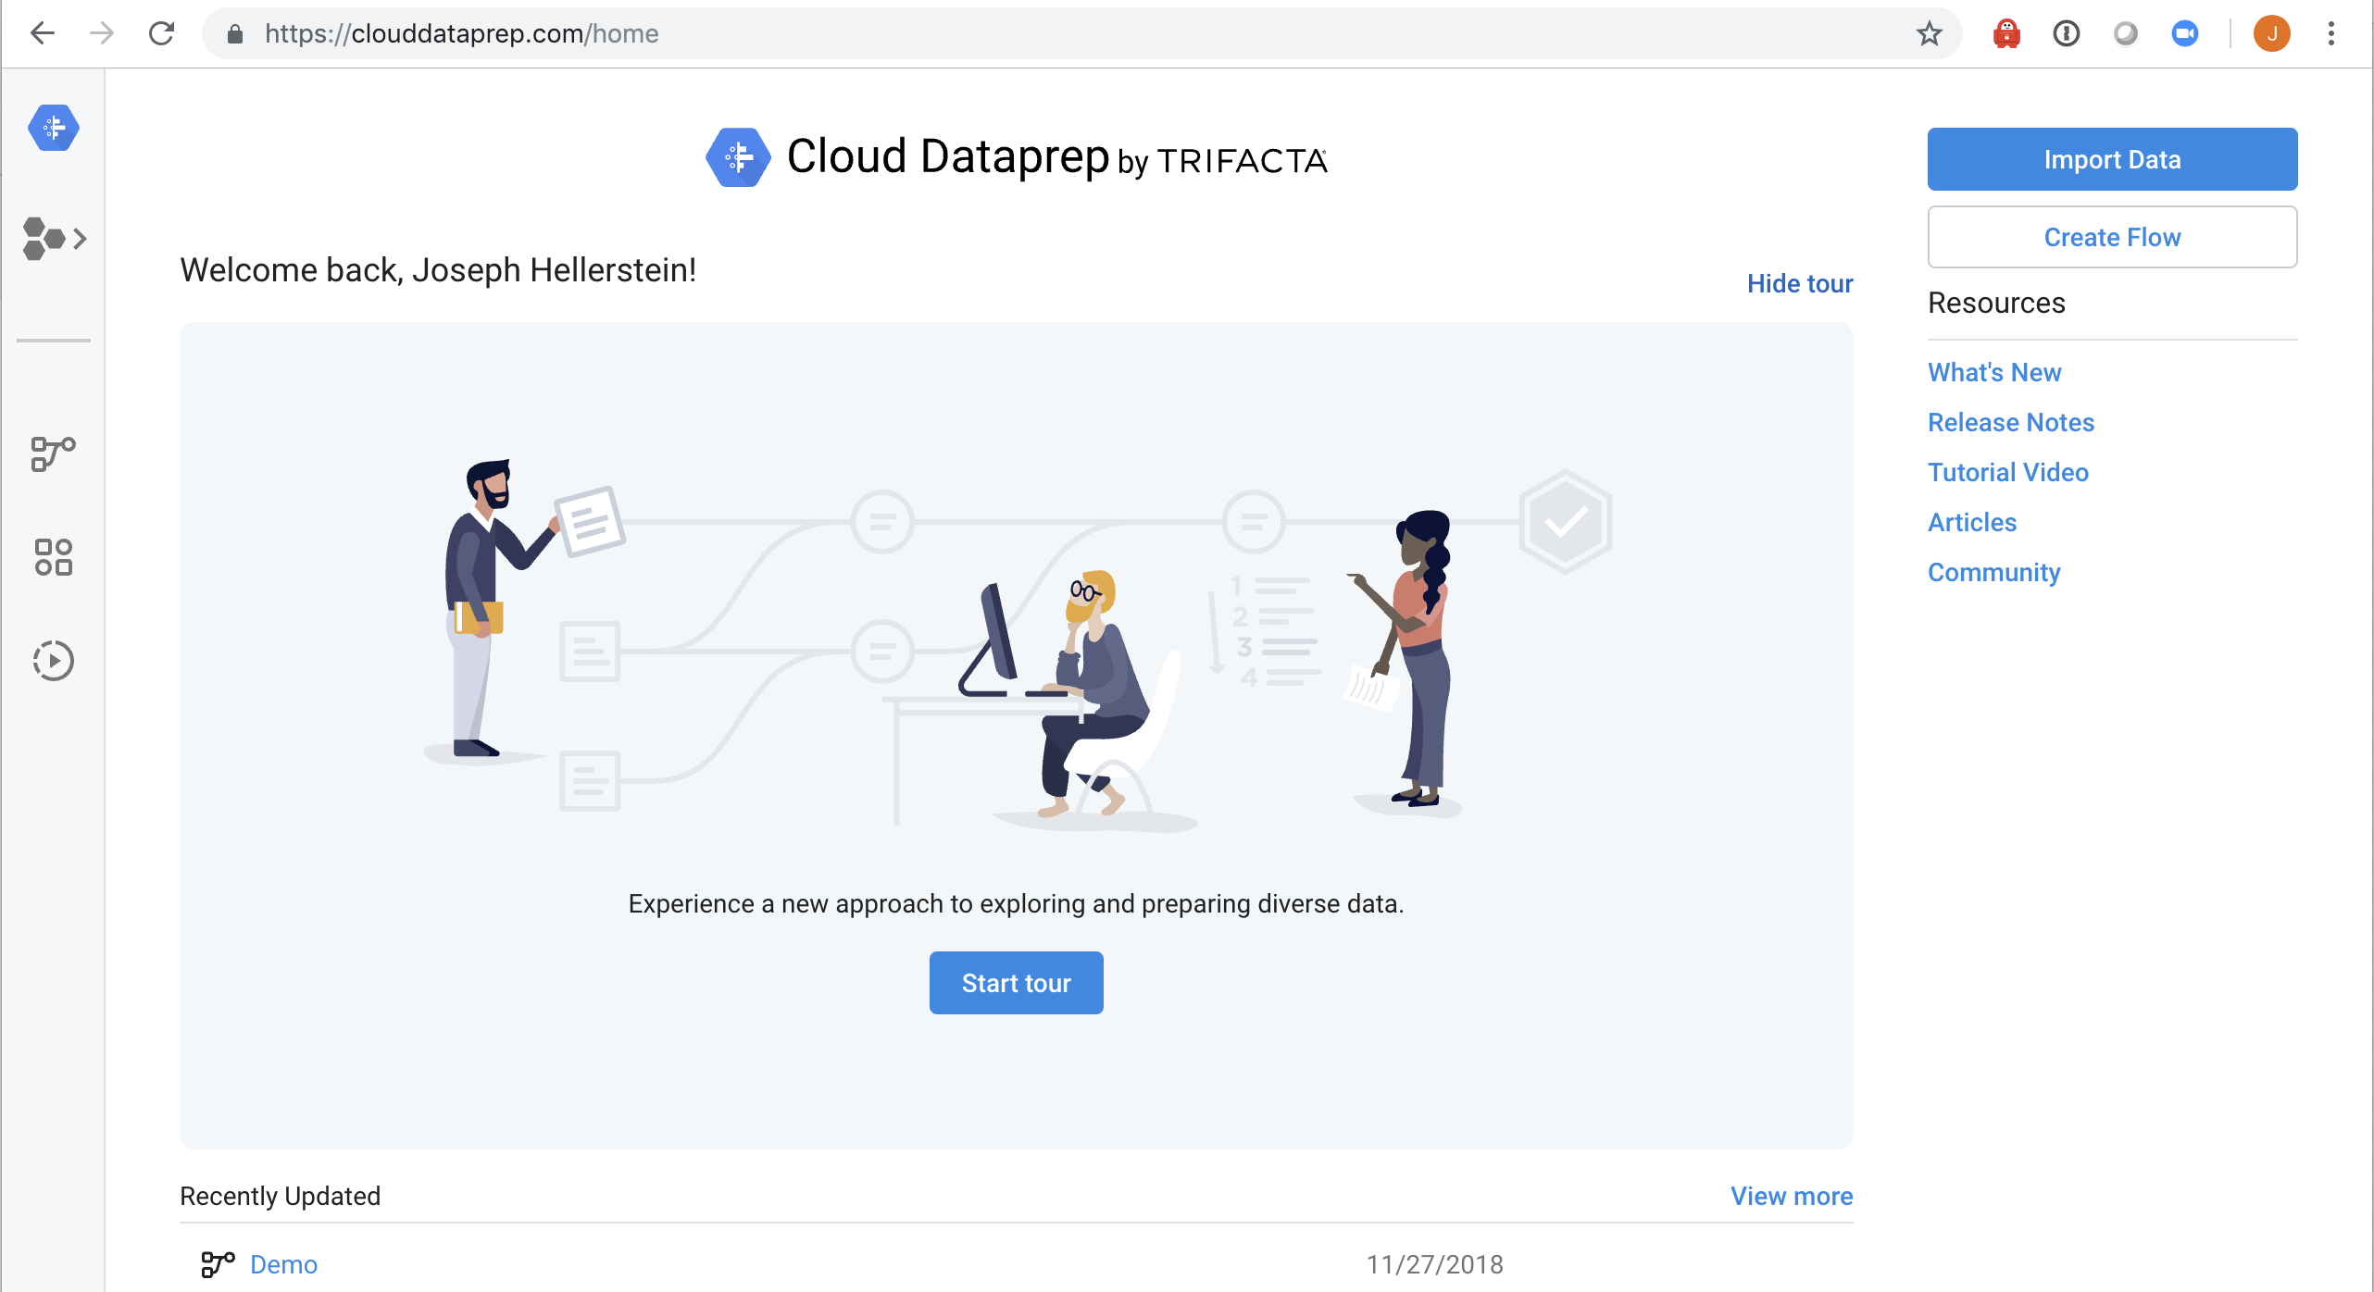
Scenario 2: Pushdown to Autoscaling Services

Slide 19
Google/Trifacta Cloud Dataprep
Memory-sized Datasets
Photon: Browser-Based Interactive Dataflow Engine
f()
GCS
BigQuery
g()
Kubernetes Services
Dataflow
Samples of Massive Datasets

Slide 20
Google/Trifacta Cloud Dataprep
f()
GCS
BigQuery
g()
Kubernetes Services
DSL Cross- Compiler
Dataflow
Autoscaling DSL

Slide 21
Google/Trifacta Cloud Dataprep
Upshot
Client provides all interactive processing
Cloud-based code either:
An interactive stateless function
A batch DSL program for an autoscaling cloud service
Nice fit to Data Wrangling
f()
GCS
BigQuery
g()
Kubernetes Services
Dataflow

Slide 22
Scenario 3: Workflow Composition
Autodesk account creation
10 mins (vs 2 week) request turnaround
24 lambdas
12 API Gateway calls
8 DB round-trips
7 SNS publish
Is 10 min good?
Huge ops cost savings!
https://aws.amazon.com/solutions/case-studies/autodesk-serverless/

Slide 23
Otherwise Not So Rosy
2
STEPS BACK
Data Processing
Distributed Computing

Slide 24
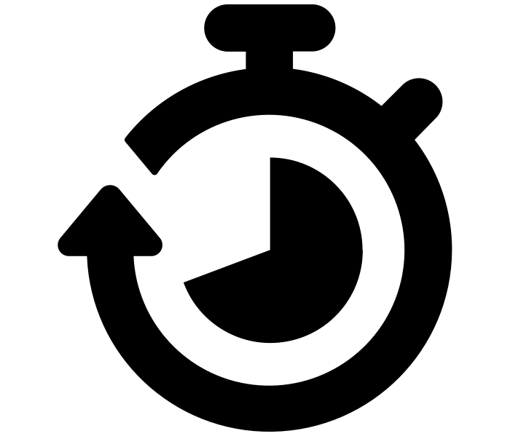
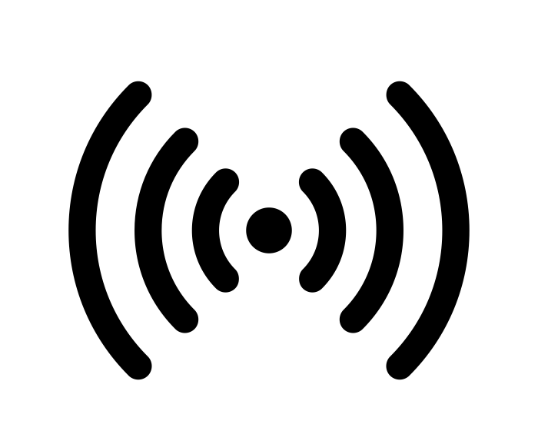
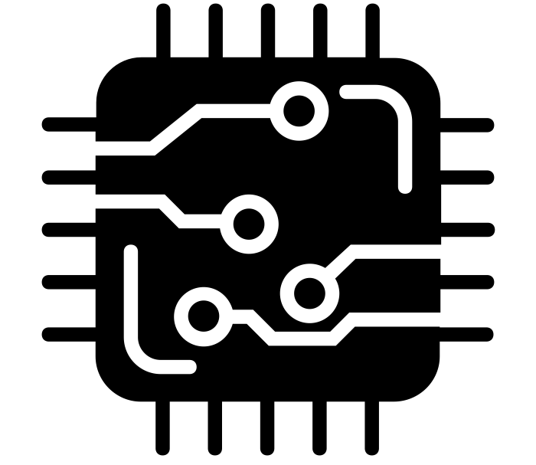
The Many Limitations of Current FaaS (Lambda)
15-min lifetimes
When your functions exits, any cached context is lost
I/O Bottlenecks
1-2 orders of magnitude slower than a modern SSD
No Inbound Network Communication
Instead, “communicate” through global services on every call
No specialized hardware
Choice of memory allocation up to 3GB
Notes:
timer by Gregor Cresnar from the Noun Project
bottleneck by Stephen Plaster from the Noun Project
Network by atlantamountain from the Noun Project
hardware by ProSymbols from the Noun Project

Slide 25
Implications
FaaS is a data-shipping architecture
FaaS stymies distributed computing
FaaS stymies use of HW-accelerated software
FaaS blocks out open-source systems software

Slide 26
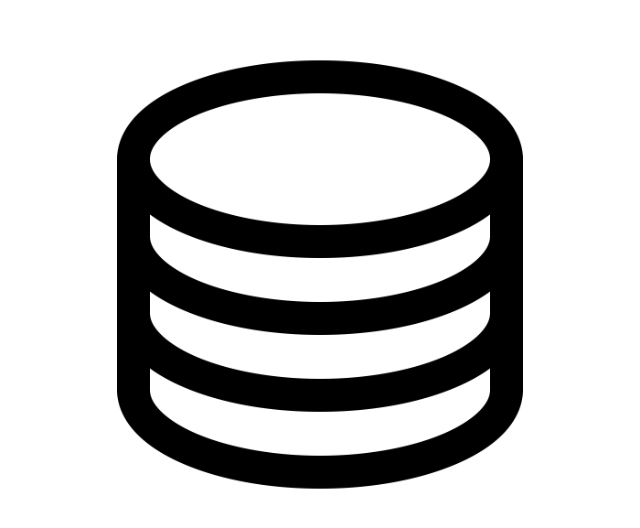
Implications
FaaS is a data-shipping architecture
f()
f()
f()
f()
f()
f()
f()
f()
f()
f()
f()
f()
f()
f()
f()
f()
f()
f()
f()
f()
f()
f()
f()
f()
f()
f()
f()
f()
f()
f()
f()
f()
f()
Notes:
Data by arjuazka from the Noun Project

Slide 27
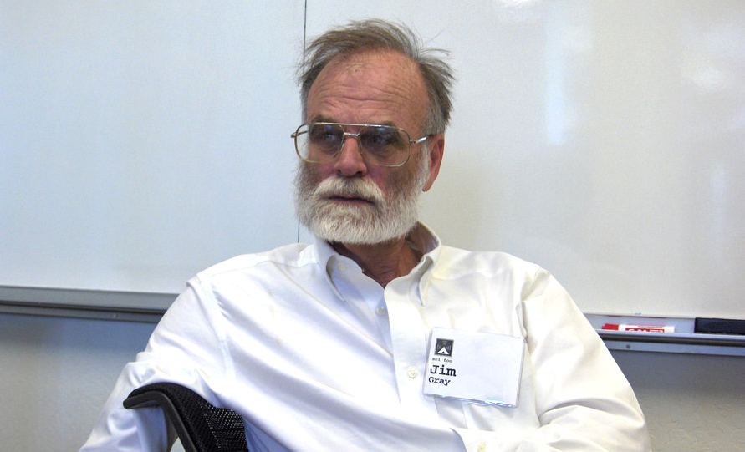
Implications
FaaS is a data-shipping architecture
f()
f()
f()
f()
f()
f()
f()
f()
f()
f()
f()
f()
f()
f()
f()
f()
f()
f()
f()
f()
f()
f()
f()
f()
f()
f()
f()
f()
f()
f()
f()
f()
f()
Notes:
Data by arjuazka from the Noun Project
Microchip by Edwin Prayogi M from the Noun Project

Slide 28
Scenario: Model Training
Lambda vs EC2
21x slower
7.3x more $$
10 passes (31 lambda calls)
465 minutes
29 cents
10 passes
22 minutes
4 cents
AWS EC2 m4.large
100MB
294 iterations in 15 min
90 GB
90 GB

Slide 29
Scenario: Prediction Serving
Lambda vs EC2
127x slower
57x more $$
AWS EC2 m4.large
Simple ‘dirty word’ classifier
Simple ‘dirty word’ classifier
0MQ
SQS
1000 batches, 10 docs ea.
447ms avg latency per batch
$1584 per Mmsgs/hr
1000 batches, 10 docs ea.
2.8ms avg latency per batch
$27.84 per Mmsgs/hr

Slide 30
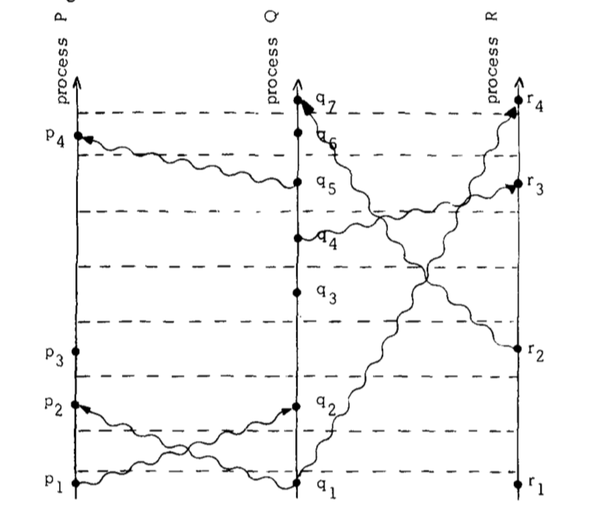
Implications
FaaS stymies distributed computing
Lamport, Time, Clocks, and the Ordering of Events in a Distributed System. 1978
Notes:
Data by arjuazka from the Noun Project
Microchip by Edwin Prayogi M from the Noun Project

Slide 31
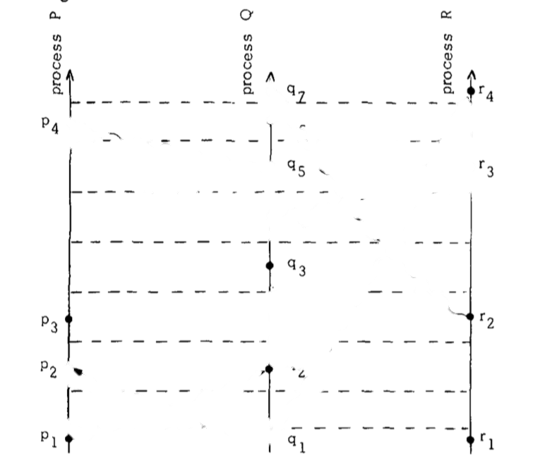
Implications
FaaS stymies distributed computing
Notes:
erase by Dan Hetteix from the Noun Project

Slide 32
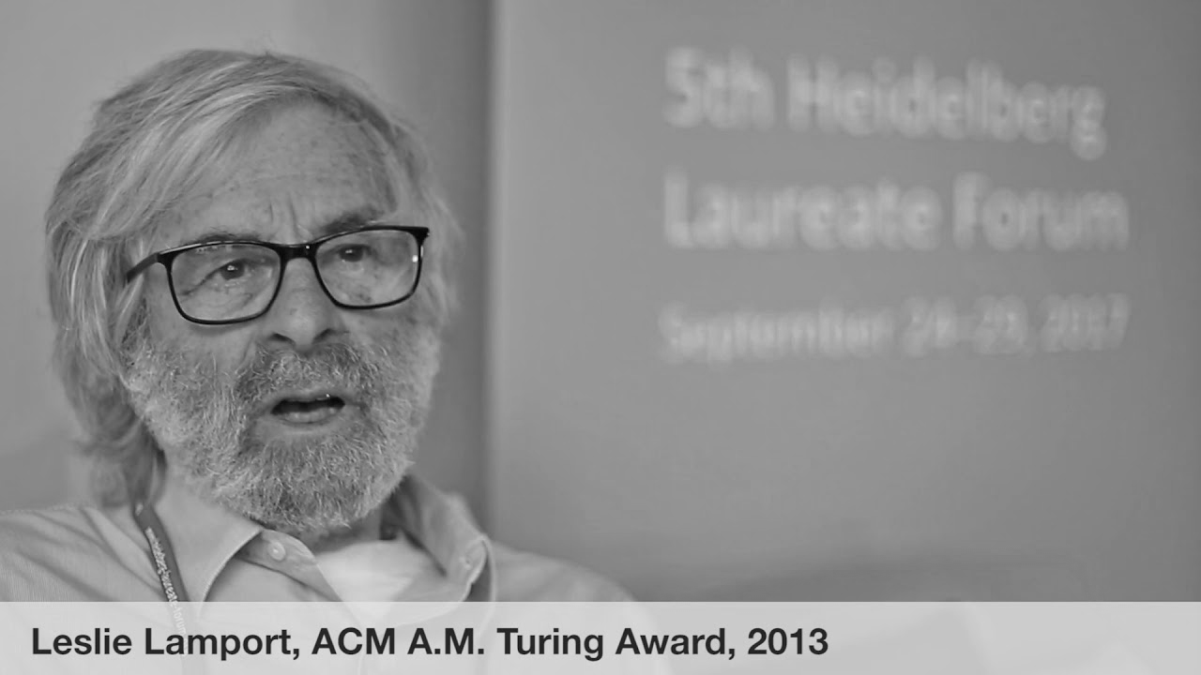
Implications
FaaS stymies distributed computing
$$$
Notes:
erase by Dan Hetteix from the Noun Project

Slide 33
Scenario: Distributed Protocols
Communication via I/O in the cloud?
0MQ on EC2 is baseline NW overhead (1x)
Ignoring Lambda, even “fast” DynamoDB is ~38x slower than NW.
With Lambda invocation, over 1000x slower

Slide 34
Scenario: Distributed Protocols
Garcia-Molina “Bully” leader election protocol, 1,000 Nodes
DynamoDB as communication medium
15-min lambda lifetimes
1.9% of system time spent on this in (unachievable) best-case
$450/hour in DynamoDB minimum bills for “communication”

Slide 35
Outline
1
Promise, Potential, Scope
2
What Works, What’s Broke
3
Objections from the Wild
4
Moving Forward on Cloud Programming

Slide 36
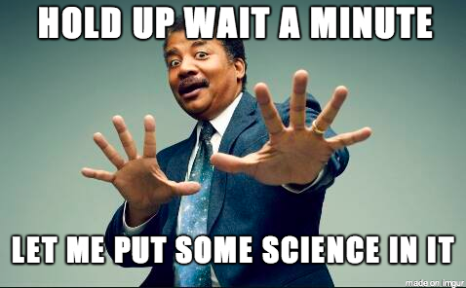
Our Colleagues Had Things to Say
Discussion summarized in the paper
Upshot: we do think there’s work to do but we’re optimistic too.

Slide 37
Hacker News Had a Few Things to Say, Too

Slide 38
Interesting HN Feedback
“Serverless is just CGI/PHP”
Con: no novelty, lack of sticky routing and caching is bad.
Pro: FaaS design patterns are Known Good Things for scalable applications
Statelessness, distant storage, etc.
“Serverless is creating a bunch of vendor lock-in & technical debt”
We did point out that possibility, gently.

Slide 39
Outline
1
Promise, Potential, Scope
2
What Works, What’s Broke
3
Objections from the Wild
4
Moving Forward on Cloud Programming

Slide 40
Future Directions for Programming the Cloud
Long-running, addressable virtual agents
Floating Named “Actors”, “Transducers” accessible via overlay routing (DHTs/KVSs)
Disorderly Programming
Languages that discourage ordered code and data. See Bloom and related work.
Flexible Programming, Common IR
Relational Algebra + Linear Algebra?
Fluid code and data placement
Logical disaggregation should not preclude physical colocation!

Slide 41
More Future Directions
SLOs
This is oddly missing today. Interesting to understand why.
HW Heterogeneity
Adds additional constraints to hard scheduling/provisioning problems
Security Concerns
Addressing increased odds of side-channel attacks

Slide 42
We’re Happy to Talk
Things change quickly these days
Including opinions!
Already some constructive feedback from colleagues working on FaaS
We are more interested in building than critiquing anyhow!

Slide 43
Conclusion
Joe Hellerstein
hellerstein@berkeley.edu
@joe_hellerstein
Cloud Programming an Open Grand Challenge
Data systems folk should engage more
As should open source community
Autoscaling is a requirement for new systems
Serverless Computing is a first taste
More work needed on data and communication

Slide 44
Clipart Credits
PDP-11 photo By Stefan_Kögl - Own work, CC BY-SA 3.0, https://commons.wikimedia.org/w/index.php?curid=466937
Mac photo from https://bytemyvdu.wordpress.com/category/plus/
Cray-1 photo By Clemens PFEIFFER - Own work, CC BY 2.5, https://commons.wikimedia.org/w/index.php?curid=1441453
iPhone photo from https://www.imore.com/iphone-2g
Jeff Bezos / Dr Evil parody posted by user Azphira at https://hardforum.com/threads/amazon-patents-drone-that-can-recognize-screaming-and-flailing.1956972/
King Cloud from Karen Ka Ying Wong at http://www.flickr.com/photos/kky/704056791/
Single white cloud on a clear blue sky from Horia Varlan at https://www.flickr.com/photos/horiavarlan/4777129318
timer by Gregor Cresnar from the Noun Project
bottleneck by Stephen Plaster from the Noun Project
Network by atlantamountain from the Noun Project
hardware by ProSymbols from the Noun Project
Data by arjuazka from the Noun Project
erase by Dan Hetteix from the Noun Project
Jim Gray, database wizard by Esther Dyson https://www.flickr.com/photos/edyson/213662710
Michael Stonebraker from https://www.bizjournals.com/boston/blog/startups/2013/04/michael-stonebraker-big-data.html
Leslie Lamport from Laureate interviews at the 5th Heidelberg Laureate Forum, https://www.youtube.com/watch?v=MYNevA7gcQA

